Slide 1
Group 6:-Minimal Viable Product
By
Tyler Maregenetti, Jack E. Massey, Eva-Elena Bulai, Marta Velartova

Slide 2
Brief
What Genre are we using?
What Mechanic are we changing?
What are we changing the mechanic into?
What emotions are we looking for?
What are the Key Programming issues we will have?
What are the Key Design problems we will face?

Slide 3
Our Game: Genre and Emotions
Platformer
Sympathy
Shock
Relief

Slide 4
Our Gaming: Programming-wise
The player can control parts of the level, but not the main character
This involves the player moving parts of the level to allow the main character to move forward, which costs “mana”

Slide 5
Gameplay
[Insert video here]

Slide 6
Meeting MVP: Programing

Slide 7
Our Game: Level Design-wise
By Eva-Elena Bulai

Slide 8
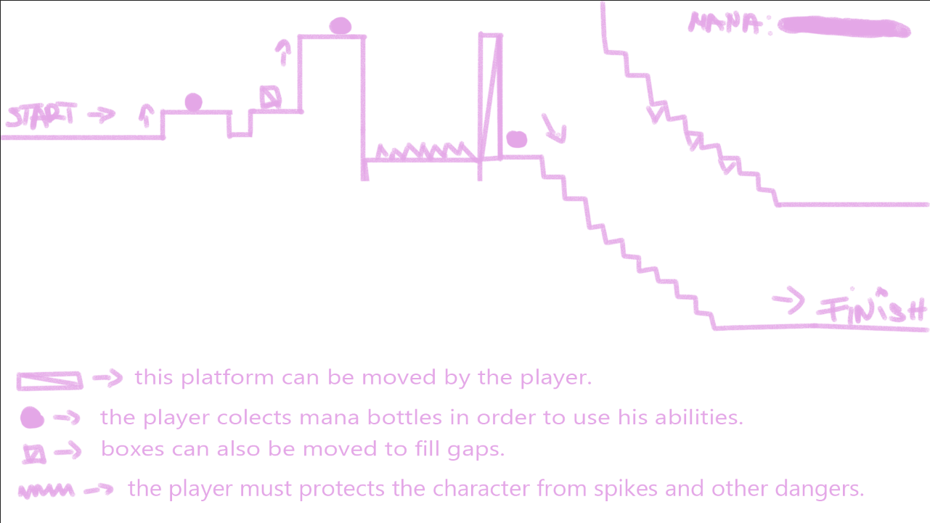
Level Design
The first level is built in such manner so the player can learn the controls and how the game works.
The difficulty slowly rises as the player runs for the finish line.

Slide 9
Meeting MVP: Level Design

Slide 10
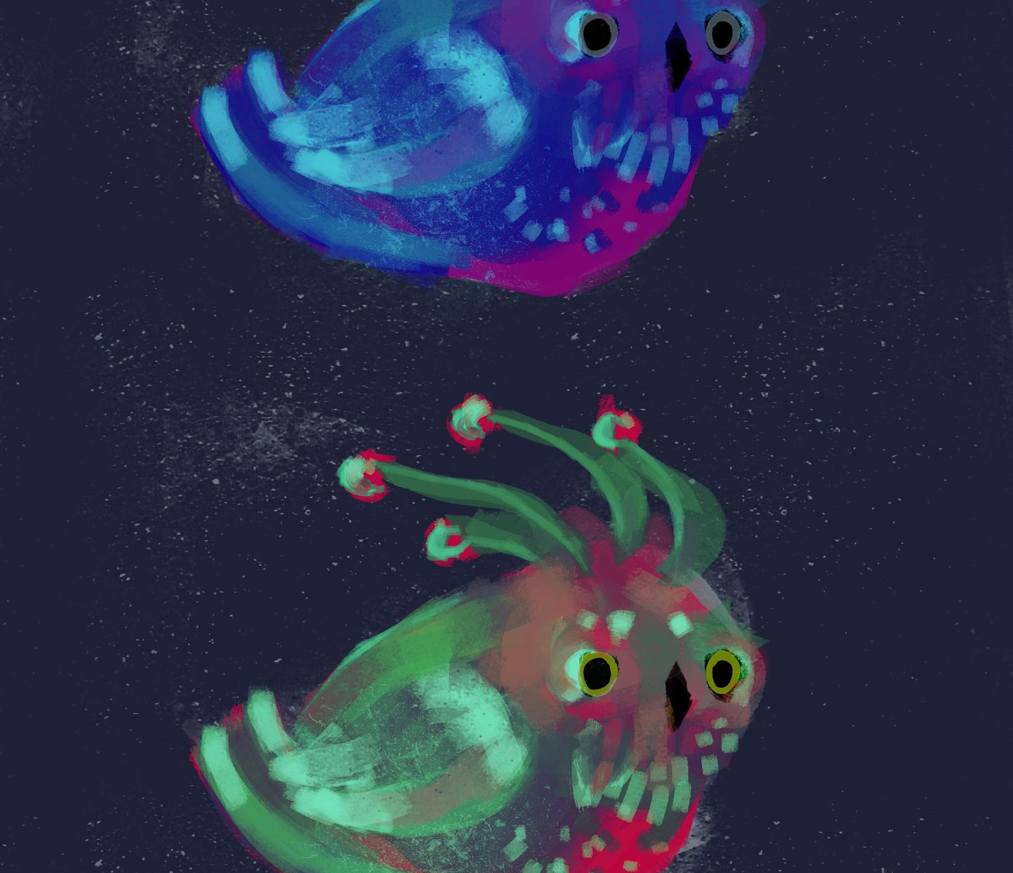
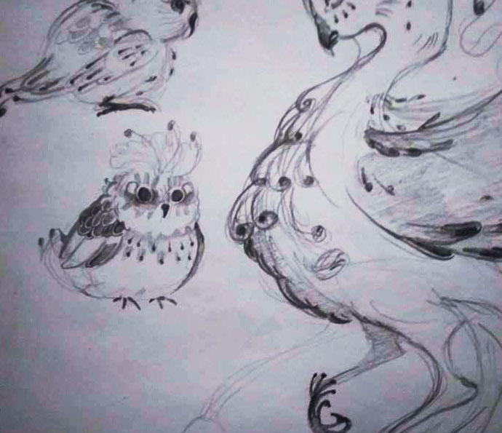
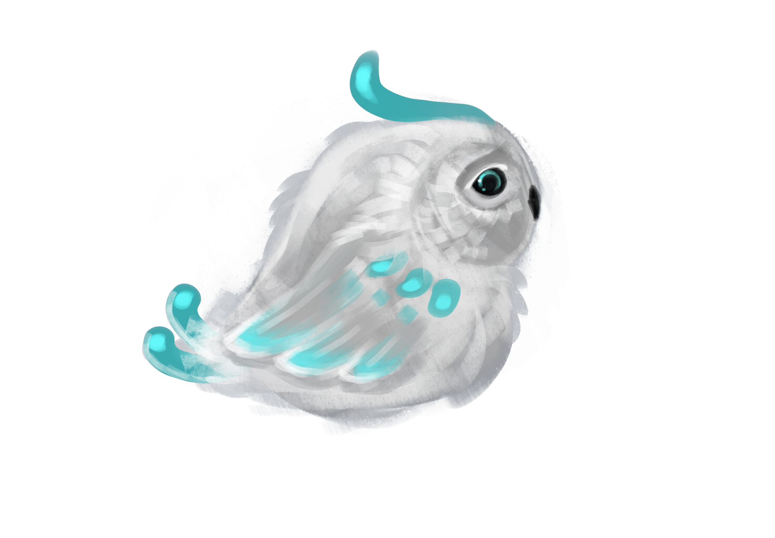
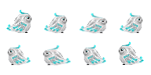
Character
Little bird from magical world fell off his nest and is trying to get home
Must be cute, and „from another world“ looking
We want player to want to protect this character - small adorable animal, sad looking
We want to create sympathy

Slide 11


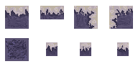
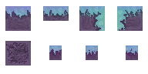



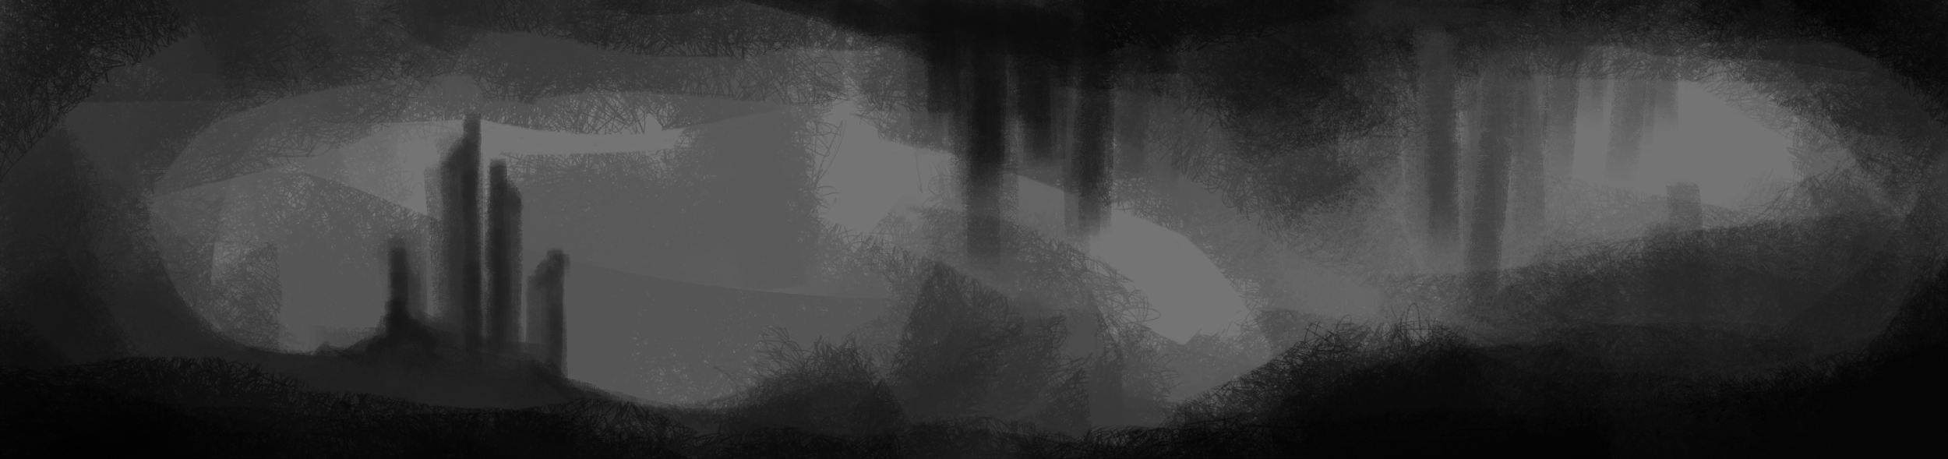
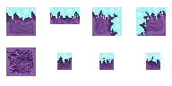
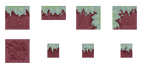

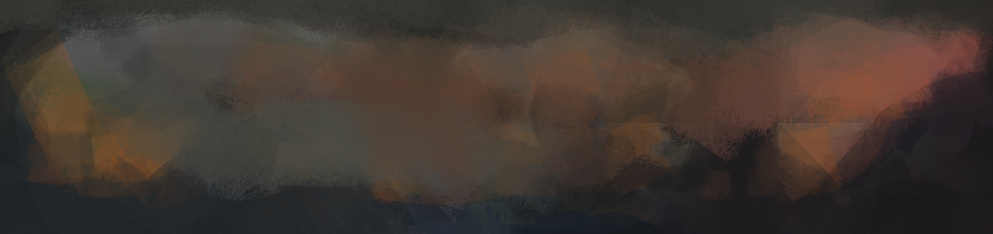
Art, assets
Character travels through different locations trying to find his way home – various locations
Starting from more dull levels (easy and not as colorful levels) and step by step is getting to the place where he belongs (colorful and more challenging levels)

Slide 12
Meeting MVP: Art

